Slide 1

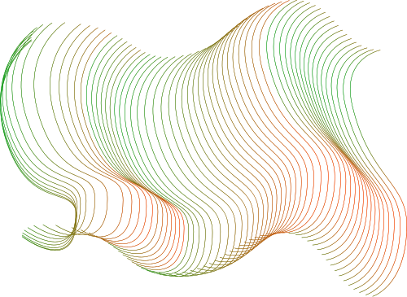
Individual Project
Loan Default Prediction
Ankit Bhandari Kshetri (21107)

Slide 2
Problem Statement
1
2
3
Granting of loans to customers with higher likelihood of default
Biased lending
practices
Missed opportunity of product development and targeted marketing

Slide 3
Predictive ML Models
Objectives
“Model”: Logistic regression
“Model 1”: Naïve Bayes classifier
“Model 2”: K-neighbors classifier
“Model 3”: Decision tree
“Model 4”: Support vector matrix
“Model 5”: Random forest
Assessing the Risks
Identification of opportunities
Evidence based strategy formulation
Building accurate predictive models
Hypothesis
Generation
Null hypothesis(H0): The customer is predicted to be unlikely to default
Alternative hypothesis(H1): The customer is predicted to be likely to default

Slide 4
Research Question
1
2
3
What is the median balance and age of the customers in the defaulter’s category?
What are the customer segments with highest number of customers?
Based on certain circumstances, will the customer default or not?

Slide 5
Features/Independent variables
ID
marital
age
education
housing
loan
month
day
duration
campaign
pdays
previous
poutcome
y (Previous subscription)
About the dataset
Dependent variable
Default: Has a previous default Yes or No

Slide 6
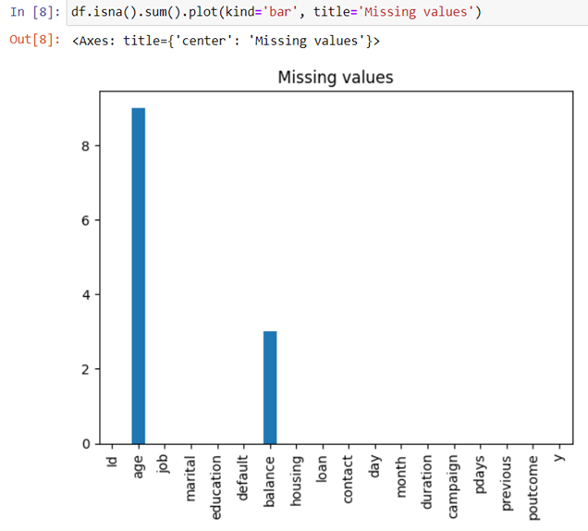
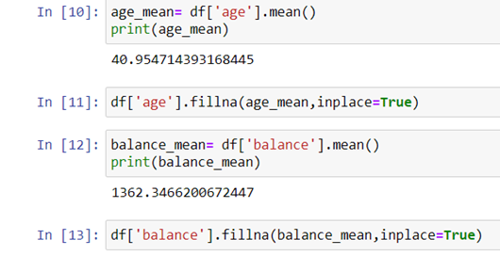
Data Preprocessing
Understanding the dataset
Data cleaning
Missing values treatment
Handling outliers(Percentile method)

Slide 7
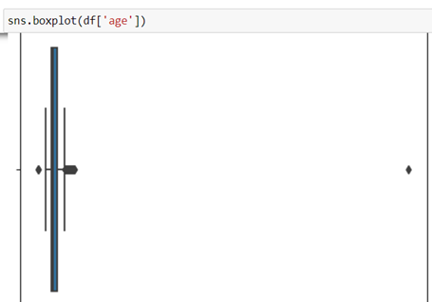
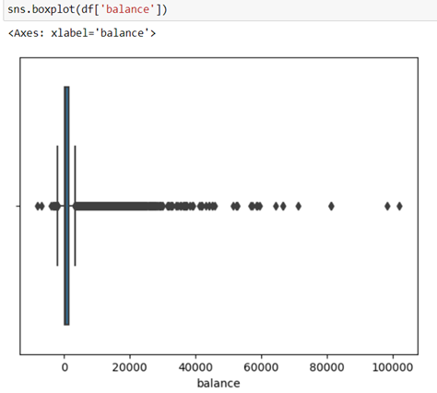
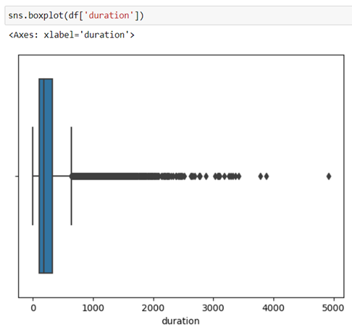
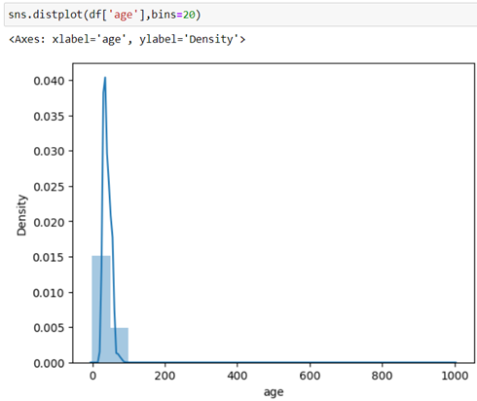
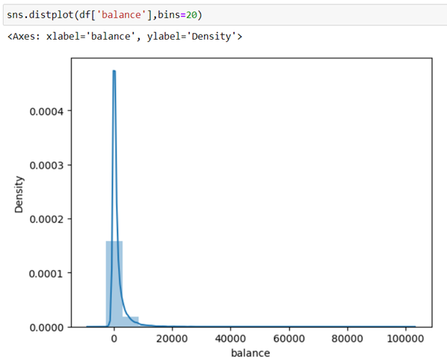
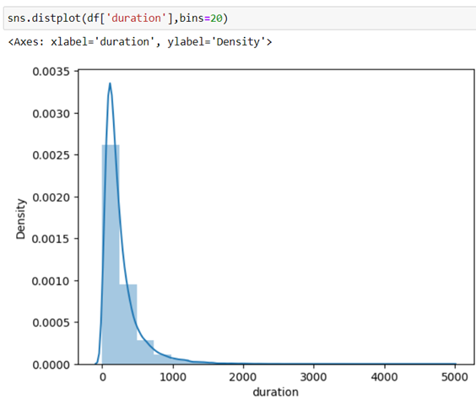
Pre cleaning Univariate analysis (Before handling outliers)

Slide 8
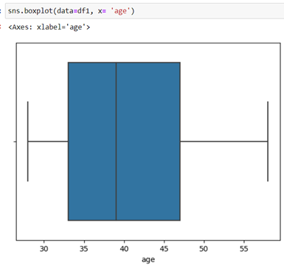
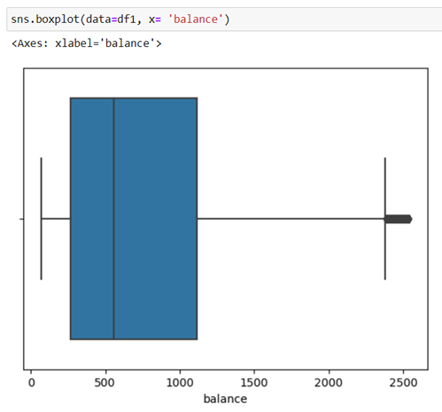
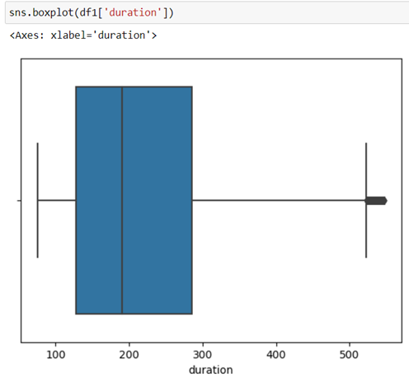
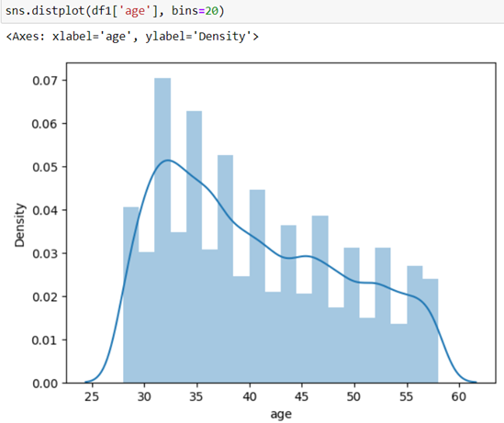
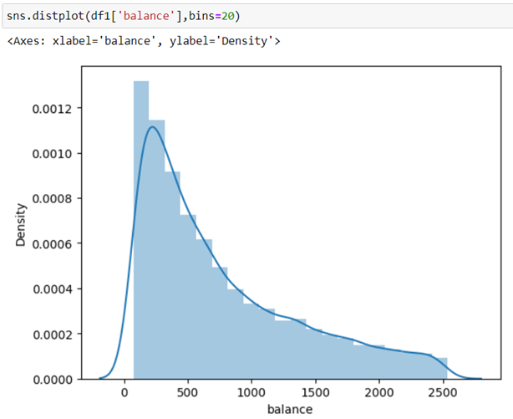
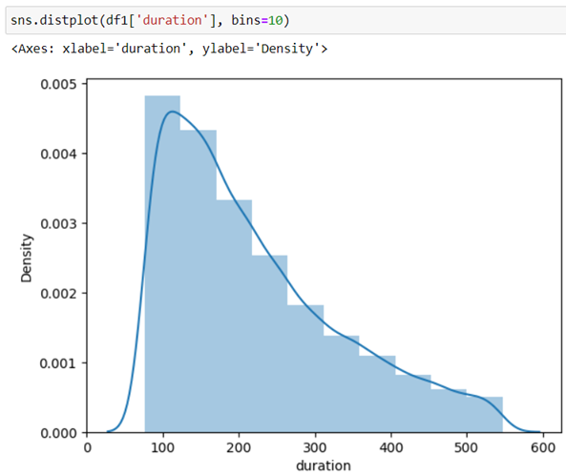
Post cleaning Univariate analysis (After handling outliers)

Slide 9
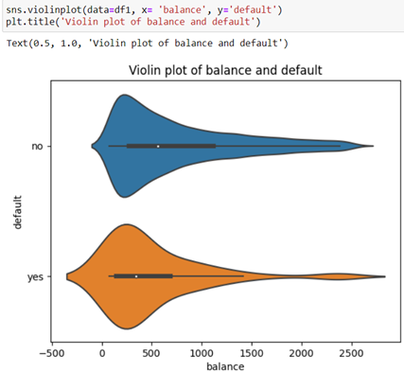
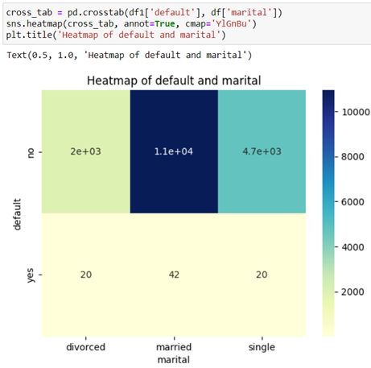
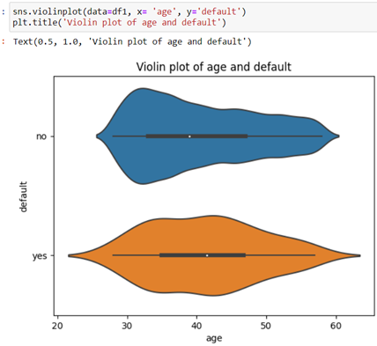
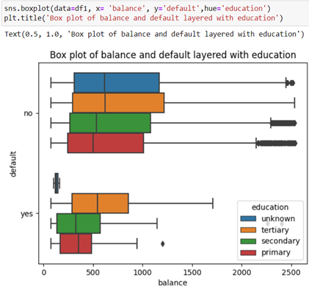
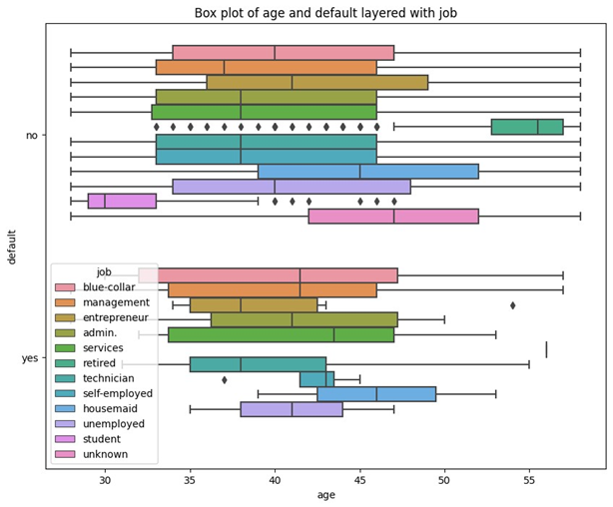
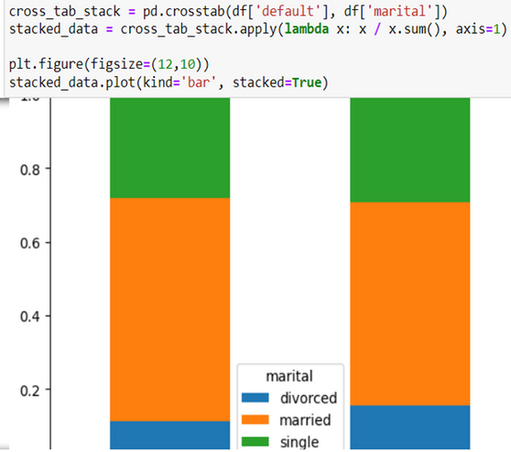
Bivariate and multivariate analysis
Balance and default
Marital and default
Age and default

Slide 10
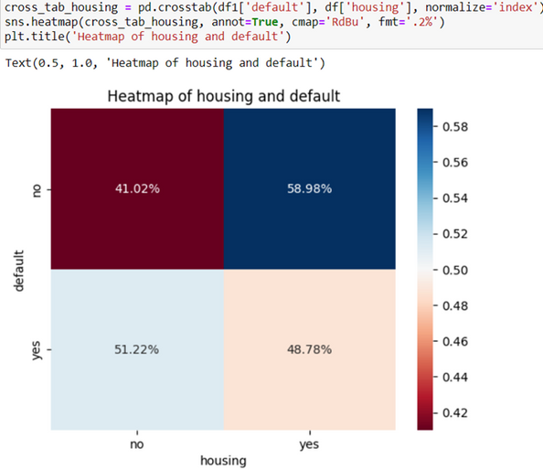
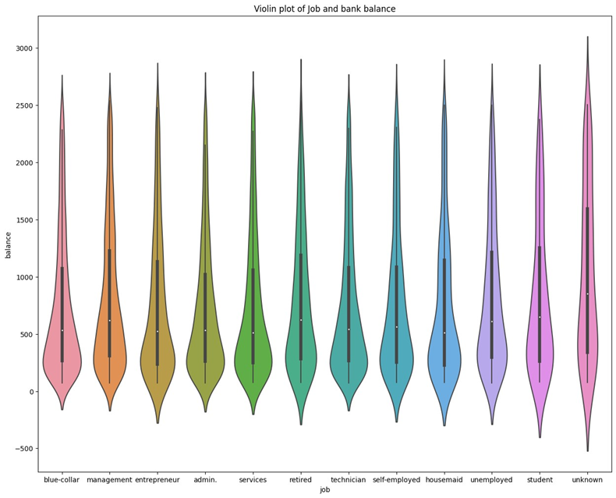
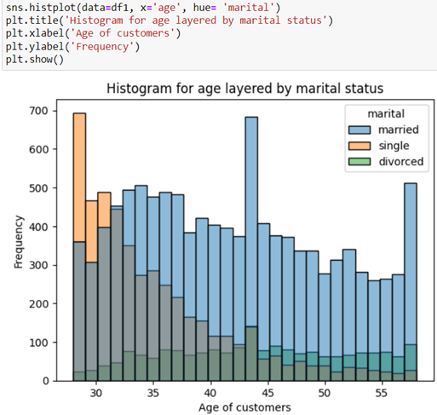
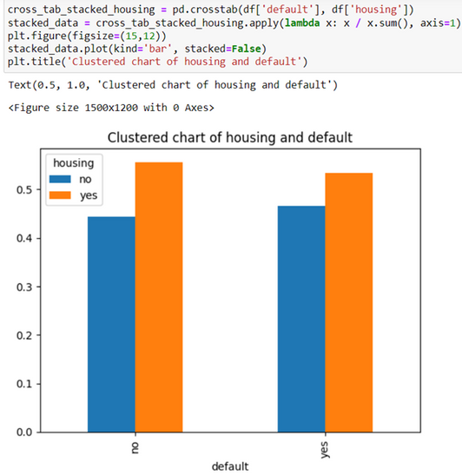
Bivariate and multivariate analysis
Housing and default
Bank balance and job
Total demographics

Slide 11
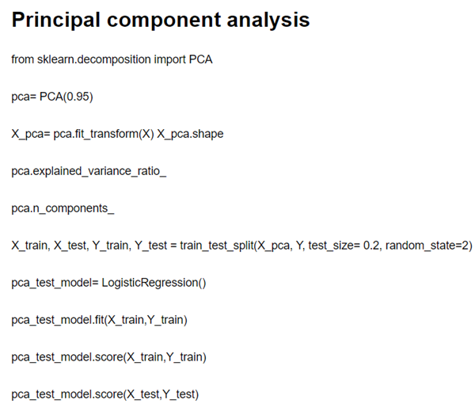
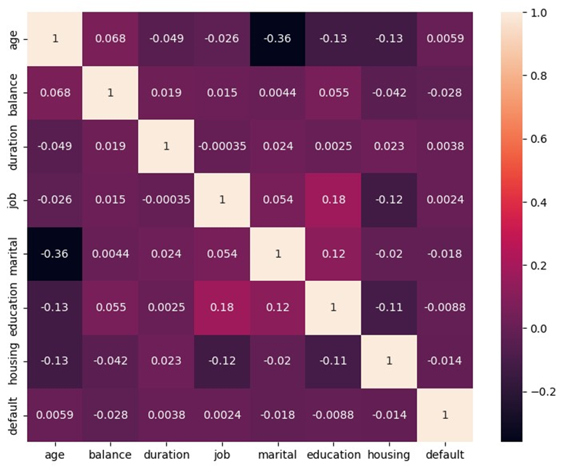
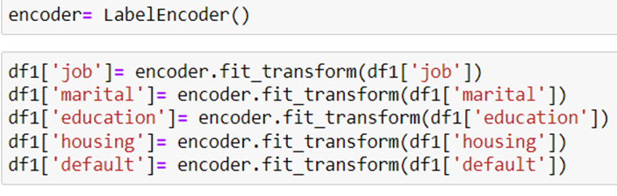
2. Feature selection
Feature engineering
Principal
Component Analysis
(PCA)
Feature encoding
Correlation
Method

Slide 12
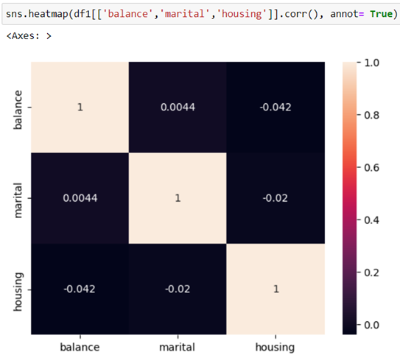
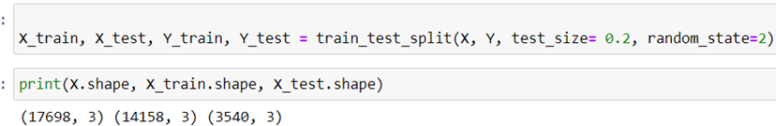
Multicollinearity check
Test train split
(80%-20%)

Slide 13
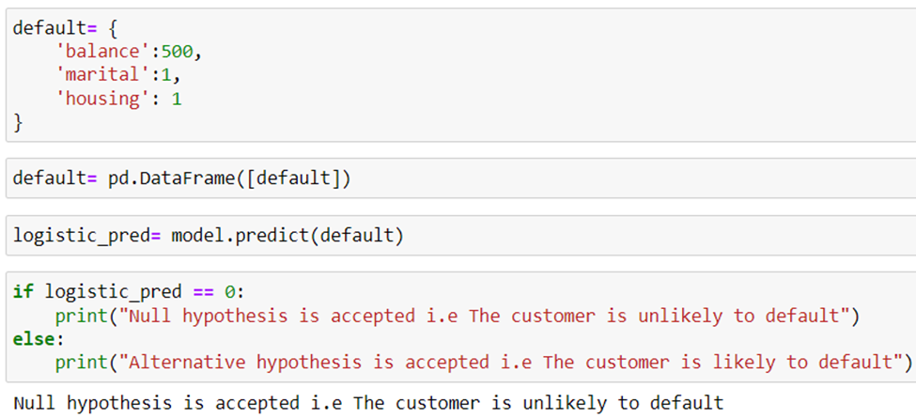
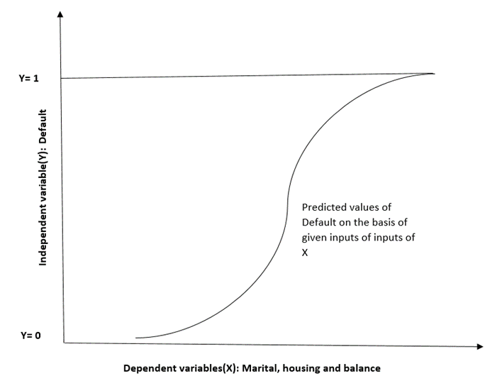
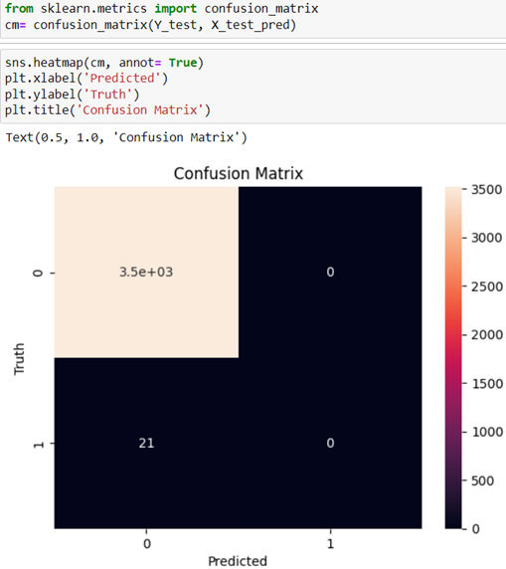
"Model": Logistic regression
Actual prediction
Model evaluation(Confusion matrix)
Train score: 99.56%
Test score: 99.40%

Slide 14
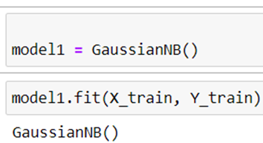
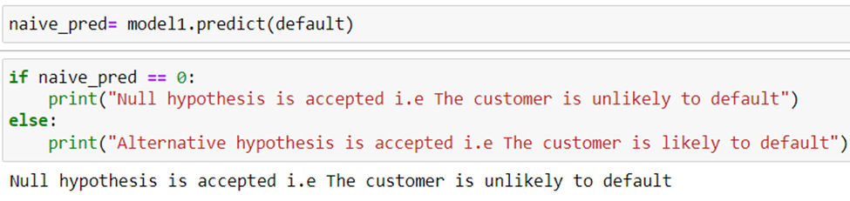
Actual prediction
"Model 1": Naive Bayes regression
(P(Default)
Bank balance, Marital status, Housing loan
NAIVE ASSUMPTION:
- Features Bank balance, Marital status, Housing loan are independent of each other (No multicollinearity)
Train score: 99.56%
Test score: 99.40%

Slide 15
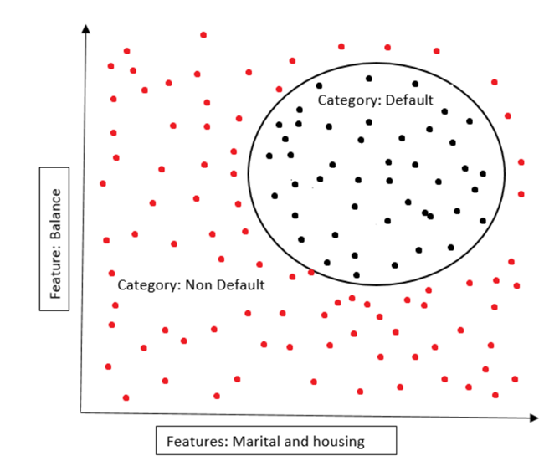
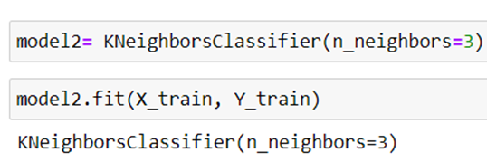
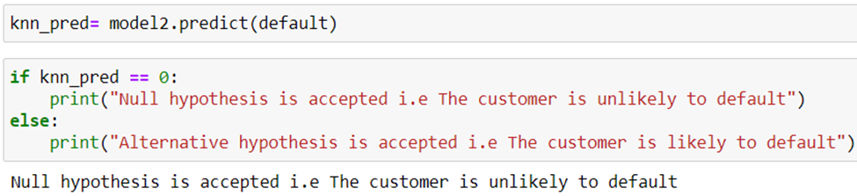
"Model 2": K Nearest neighbor
Actual prediction
Train score: 99.59%
Test score: 99.37%

Slide 16
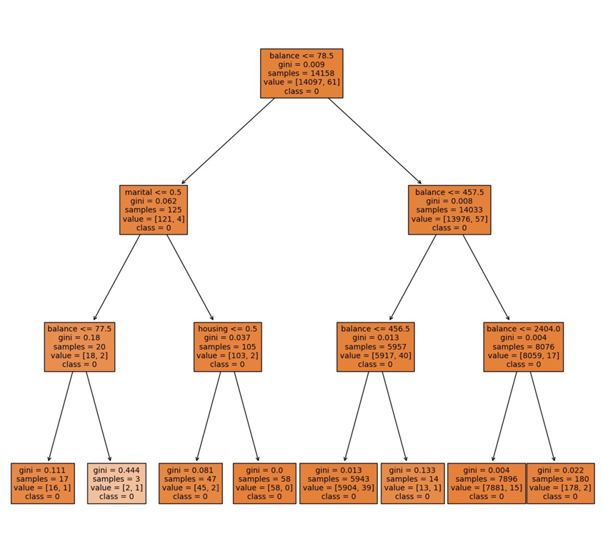
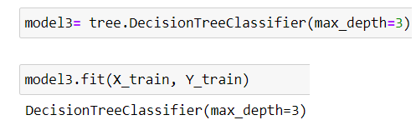
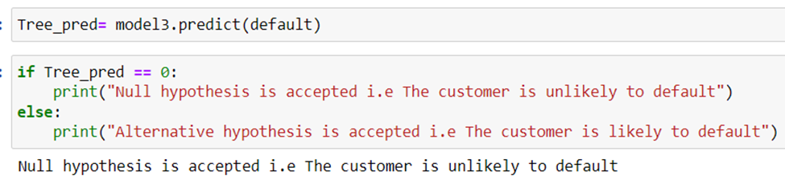
"Model 3": Decision tree
Prediction visualization
Train score: 99.56%
Test score: 99.40%

Slide 17
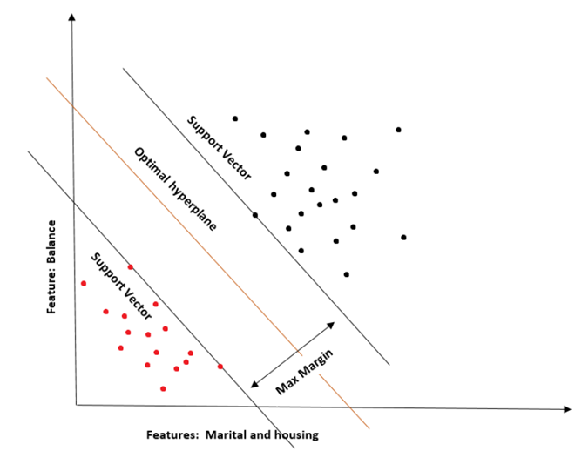
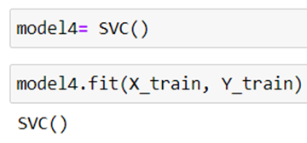
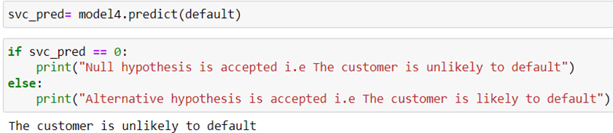
"Model 4": Support vector machine
Actual prediction
Train score: 99.56%
Test score: 99.40%

Slide 18
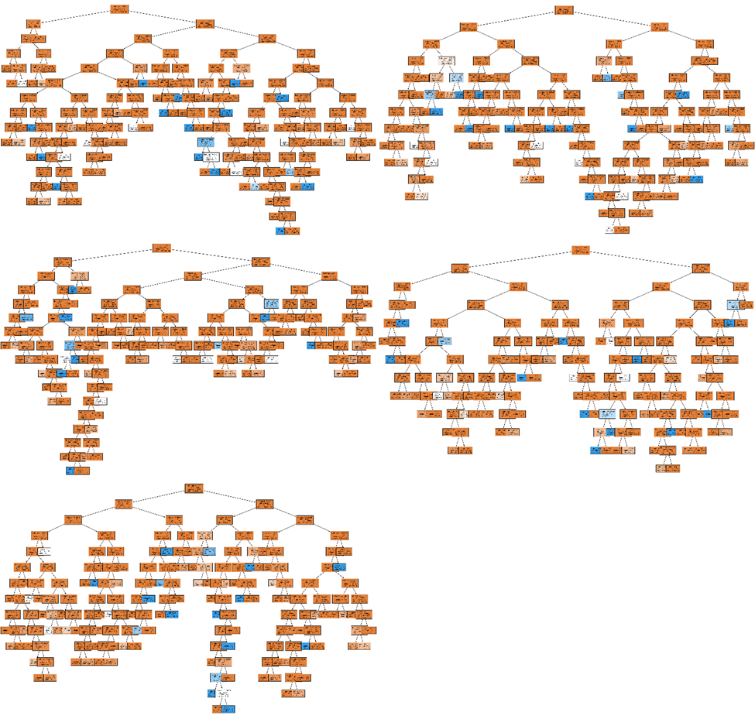
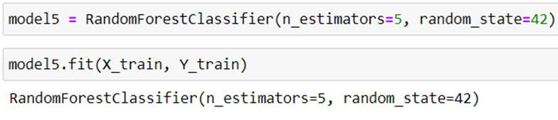
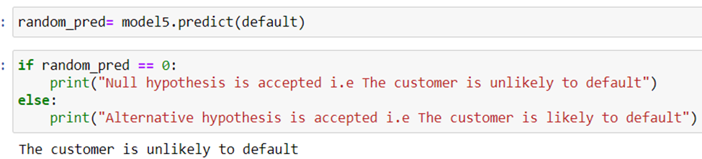
"Model 5": Random forest
Prediction visualization
Train score: 99.64%
Test score: 99.29%

Slide 19
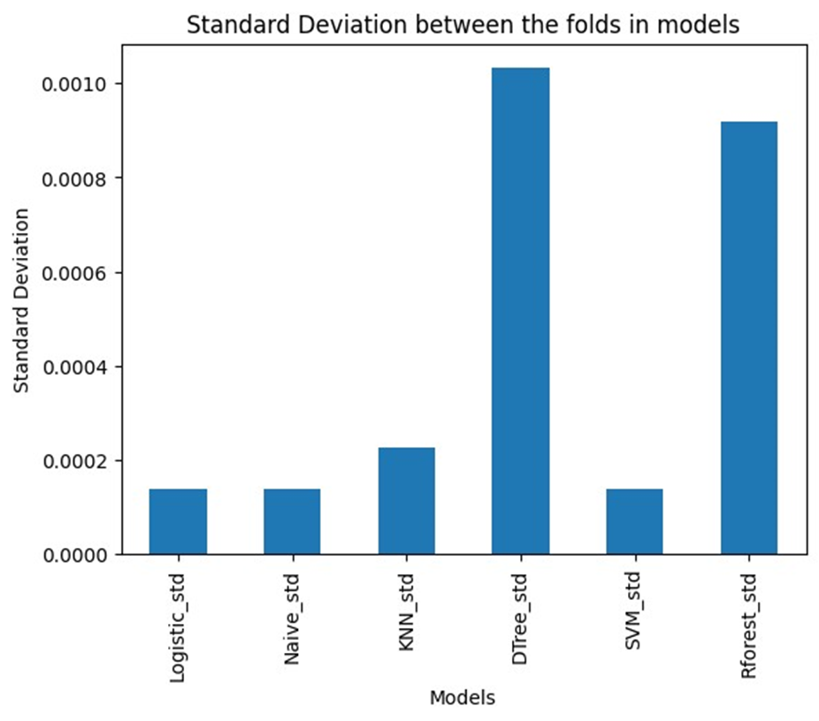
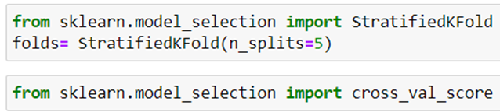

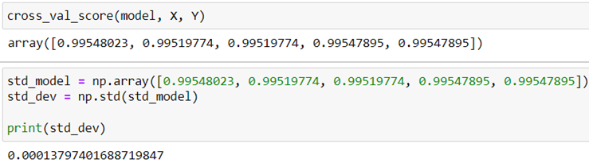
Best model selection: Cross Validation (Stratified K fold)
Calculation of Score and Std dev
Why Logistic regression?
Well suited for binary classification
Limited number of features
SVM assumes no multicollinearity at all

Slide 20
Increasing the minimum bank balance threshold to above 500 Euros for loan approval | Issue less SUBPRIME loans on the housing loan portfolio
Targeted risk assessment and monitoring strategies for married customers | New product development; senior citizen fixed deposit scheme
Increased scrutiny for housemaids above the median age of 40 | Targeted Marketing strategies for 3 major identified segments
3 major idetified segments: Age between 28 and 43 Married customers Retired people in their 60s | 3 major idetified segments: Age between 28 and 43 Married customers Retired people in their 60s
Managerial
Implications

Slide 21
Probable Sample Bias
Data Quality
Exogenous Factors
Limitations

Slide 22
Codebasics. (2017). Machine Learning Tutorial Python. https://www.youtube.com/watch?v=FB5EdxAGxQg&ab_channel=codebasics.
Pandian, S. (2017, Februray 17). Analytics Vidya . Retrieved from https://www.analyticsvidhya.com/blog/2022/02/k-fold-cross-validation-technique-and-its-essentials/
YAMAHATA, H. (2017). Kaggle . Retrieved from Kaggle.com : https://www.kaggle.com/datasets/henriqueyamahata/bank-marketing
References

Slide 23

Thank You

